Slide 1
Securing Information Systems
Chapter 8
Notes:
‹#›

Slide 2
Learning Objectives
Explain why information systems are vulnerable to destruction, error, and abuse.
Describe the business value of security and control.
Describe the components of an organizational framework for security and control.
Describe the tools and technologies used for safeguarding information resources.
Notes:
This chapter discusses the need for security to guard information systems and data as well as technologies used secure information systems. Ask students what types of threats can harm an information system. Internet security, or the lack thereof, will continue to be a topic of major concern to corporations and countries. Ask students why there is so much attention paid to Internet security issues in the press. Ask if anyone has been a victim of a breach in computer security.
‹#›

Slide 3
System Vulnerability and Abuse
Security:
Policies, procedures, and technical measures used to prevent unauthorized access, alteration, theft, or physical damage to information systems
Controls:
Methods, policies, and organizational procedures that ensure safety of organization’s assets; accuracy and reliability of its accounting records; and operational adherence to management standards
Notes:
This slide introduces the need for both security and controls in today’s businesses in order to safeguard information systems. Ask students to give an example of security technique and an example of a control that might be used in a business.
‹#›

Slide 4
System Vulnerability and Abuse
Why systems are vulnerable
Accessibility of networks
Hardware problems (breakdowns, configuration errors, damage from improper use or crime)
Software problems (programming errors, installation errors, unauthorized changes)
Disasters
Computers outside of firm’s control
Loss and theft of portable devices
Notes:
This slide discusses the main categories of threats to information systems. Note that when large amounts of data are stored digitally, on computers and servers and in databases, they are vulnerable to many more kinds of threats than when they were stored in manual form, on paper in folders and file cabinets. When data are available over a network, there are even more vulnerabilities. Ask students if they have ever lost data on their computers. What was the reason (hardware, software, “disaster,” other people, etc.). On the other hand, digital records are not vulnerable in ways that manual records in a file cabinet are vulnerable. For instance, you really can’t tell who has accessed manual records, or when, in a physical file. In a database, file access is monitored (unless a hacker has found a way to read records without leaving a digital trail).
‹#›

Slide 5
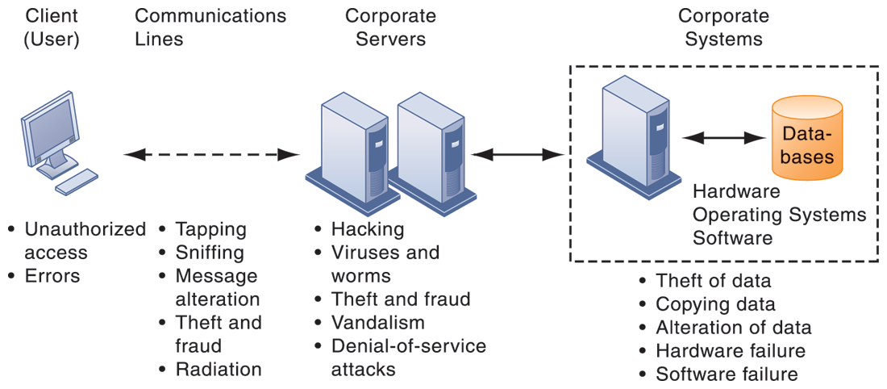
CONTEMPORARY SECURITY CHALLENGES AND VULNERABILITIES
FIGURE 8-1
The architecture of a Web-based application typically includes a Web client, a server, and corporate information systems linked to databases. Each of these components presents security challenges and vulnerabilities. Floods, fires, power failures, and other electrical problems can cause disruptions at any point in the network.
Notes:
This graphic illustrates the types of threats to system security and the points over the network at which these threats are prevalent. Some problems occur at the client computer, others through the network lines, corporate servers, or in corporate hardware and software.
‹#›

Slide 6
System Vulnerability and Abuse
Malware (malicious software)
Viruses
Rogue software program that attaches itself to other software programs or data files in order to be executed
Worms
Independent programs that copy themselves from one computer to other computers over a network.
Worms and viruses spread by
Downloads (drive-by downloads)
E-mail, IM attachments
Downloads on Web sites and social networks
Notes:
This slide identifies the various types of malware that threaten information systems and computers. Ask students if they have ever had a problem with a virus. Do they know how they got infected? Note that there are now more than 200 viruses and worms targeting mobile phones, and Web 2.0 applications such as MySpace and blogs are new conduits for malware and spyware. Malware is a serious problem—over the past decade, worms and viruses have caused billions of dollars of damage to corporate networks, e-mail systems, and data.
‹#›

Slide 7
System Vulnerability and Abuse
Malware (cont.)
Smartphones as vulnerable as computers
Study finds 13,000 types of smartphone malware
Trojan horses
Software that appears caring but does something other than expected
SQL injection attacks
Hackers submit data to Web forms that exploits site’s unprotected software and sends rogue SQL query to database
Ransomware
Notes:
This slide continues the discussion of types of malware on the previous slide. Note that SQL injection attacks are the largest malware threat. Ask students why this is so. (These attacks enable hackers access to underlying databases that support Web applications, such as sales of products and services, e-commerce financial data, and other classified information. In other words, the database is where the information is located. SQL databases have little or no built in security once a hacker gets beyond the entrance point to a corporate network).
‹#›

Slide 8
System Vulnerability and Abuse
Malware (cont.)
Spyware
Small programs install themselves secretly on computers to monitor user Web surfing activity and serve up advertising
Key loggers
Record every keystroke on computer to steal serial numbers, passwords
Other types:
Redirect search requests
Slow computer performance by taking up memory
Notes:
This slide continues the discussion of malware.
‹#›

Slide 9
System Vulnerability and Abuse
Hackers and computer crime
Hackers vs. crackers
Activities include:
System intrusion
System damage
Cybervandalism
Intentional disruption, disfigurement, destruction of Web site or corporate information system
Notes:
This slide looks at the people who commit computer crime, and at the various types of computer crime.
Ask students what the difference is between hackers and crackers and if they agree with the differentiation. Have any students been the victim of computer crime or invasion of privacy?
‹#›

Slide 10
System Vulnerability and Abuse
Spoofing
Misrepresenting oneself by using fake e-mail addresses or masquerading as someone else
Sniffer
Spying program that monitors information traveling over network
Enables hackers to steal proprietary information such as e-mail, company files, and so on
Notes:
This slide continues the discussion of different types of computer crimes. Ask students what the ultimate purpose of spoofing and sniffing are. Note that there are legitimate uses of sniffing—sniffers can help identify network trouble spots or spot criminal activity on a network. Sniffers can also be used to identify copyrighted data being sent over networks, such as pirated music or video files.
‹#›

Slide 11
System Vulnerability and Abuse
Denial-of-service attacks (DoS)
Flooding server with thousands of false requests to crash the network
Distributed denial-of-service attacks (DDoS)
Use of numerous computers to launch a DoS
Botnets
Networks of “zombie” PCs penetrated by bot malware
Deliver 90 percent of world spam, 80 percent of world malware
Grum botnet: controlled 560K to 840K computers
Notes:
This slide continues the discussion of the types of computer crimes. What is the result of a DoS attack? The text gives the example of the Grum botnet, which was responsible for 18% of worldwide spam traffic (18 billion messages a day) until it was shut down on July 19, 2012. Bots and botnets are an extremely serious threat because they can be used to launch very large attacks using many different techniques.
‹#›

Slide 12
System Vulnerability and Abuse
Cybercrime
Cybercrime is a crime that involves a computer and a network. Cybercrime may harm someone's security and financial health.
Computer may be target of crime, for example:
Breaching confidentiality of protected computerized data
Accessing a computer system without authority
Computer may be instrument of crime, for example:
Theft of trade secrets
Using e-mail for threats or harassment
Notes:
This slide looks at the legal definition of computer crime and the two main classes of computer crime. The text lists a variety of other examples for computers as targets and as instruments of crime. Ask the students to provide more examples. According to the Ponemon Institute, the median annual cost of cybercrime for organizations in their study was $5.9 million. However, many companies are reluctant to report computer crimes. Why? What are the most economically damaging types of computer crime? (DoS, introducing viruses, theft of services, disruption of computer systems)
‹#›

Slide 13
Online gambling: There are millions of websites; all hosted on serves abroad, that offer online gambling. In fact, it is believed that many of these websites are actually fronts for money laundering.
Forgery: Currency notes, postage and revenue stamp, mark sheets etc. can be forged using sophisticated computers, printers and scanner.
E-mail bombing: E-mail bombing refers to sending a large numbers of e-mails to the victims resulting in the victim’s e-mail account (in case of an individual) or mail servers ( in case of a company or an e-mail service provider) crashing.

Slide 14
Salami attacks: These attacks are used for the commission of financial crime. A bank employee insert a program, into the bank’s servers, that deducts a small amount of money ( say 5 taka a month).
Web jacking: This occurs when someone forcefully takes control of a website ( by cracking the password and later changing it).
Notes:
‹#›

Slide 15
E-mail threatening to the Prime Minister Sheikh Hasina from a cyber café.
Hacking the mail of BRAC BD
Stealing the transaction report of Dhaka Stock Exchange (DSE)
Inserting porno movies to the web site of Bangladesh National Parliament.

Slide 16
Inserting porno movies to the web site of Jamate Islami Bangladesh.
E-mail threatening to World Bank Dhaka office and the former president of the United States George Bush.
Hacking the website of Rapid Action Battalion (RAB).

Slide 17
System Vulnerability and Abuse
Identity theft
Theft of personal Information (social security ID, driver’s license, or credit card numbers) to impersonate someone else
Phishing
Setting up fake Web sites or sending e-mail messages that look like legitimate businesses to ask users for confidential personal data
Evil twins
Wireless networks that pretend to offer trustworthy Wi-Fi connections to the Internet
Notes:
This slide continues the discussion of types of computer crime. Have any students encountered any of these types of crimes personally? Note that The U.S. Congress addressed the threat of computer crime in 1986 with the Computer Fraud and Abuse Act. This act makes it illegal to access a computer system without authorization. The text lists other legislation to counter computer crime, such as the National Information Infrastructure Protection Act in 1996 to make virus distribution and hacker attacks to disable Web sites federal crimes.
‹#›

Slide 18
System Vulnerability and Abuse
Pharming
Redirects users to a bogus Web page, even when individual types correct Web page address into his or her browser
Click fraud
Occurs when individual or computer program fraudulently clicks on online ad without any intention of learning more about the advertiser or making a purchase
Cyberterrorism and Cyberwarfare
Notes:
This slide continues the discussion of types of computer crime. Note that cybercriminal activities are borderless: The global nature of the Internet makes it possible for cybercriminals to operate anywhere in the world. Ask students if there should be legislation outlawing click fraud. One concern is the use of computer attacks by organized governments, and that such attacks might target major infrastructure such as electrical grids. The text says that at least 20 countries, including China, are believed to be developing offensive and defensive cyberwarfare capabilities. One of the leading, if not the leading, countries in cyberwarfare is the United States.
‹#›

Slide 19
System Vulnerability and Abuse
Internal threats: Employees
Security threats often originate inside an organization
Inside knowledge
Sloppy security procedures
User lack of knowledge
Social engineering:
Tricking employees into revealing their passwords by pretending to be legitimate members of the company in need of information
Notes:
This slide looks at another source of security problems—people inside the company with access to the system. Ask students if they have ever worked somewhere with a vulnerable password system. Have they ever revealed to anyone what their password is or was? What are some solutions to password security? Some financial institutions assign users a new password every day, or every hour.
‹#›

Slide 20
System Vulnerability and Abuse
Software vulnerability
Commercial software contains flaws that create security vulnerabilities
Hidden bugs (program code defects)
Zero defects cannot be achieved because complete testing is not possible with large programs
Flaws can open networks to intruders
Patches
Small pieces of software to repair flaws
Notes:
This slide looks at security and other vulnerabilities caused by software errors that open networks to intruders. The text cites the example of a database-related software error that prevented millions of JP Morgan Chase retail and small-business customers from accessing their online bank accounts for two days in September 2010. Ask students why complete testing is not possible with large programs.
The text also gives the example of Microsoft’s service pack upgrades to its operating system software. Service Pack 1 for Vista included security enhancements to counter malware and hackers.
‹#›

Slide 21
Organizational Frameworks for Security and Control
Information systems controls
Controls are methods, policies, and organizational procedures that ensure safety of organization’s assets; accuracy and reliability of its accounting records; and operational adherence to management standards.
Manual and automated controls
General and application controls
General controls
Govern design, security, and use of computer programs and security of data files in general throughout organization’s information technology infrastructure
Combination of hardware, software, and manual procedures to create overall control environment
Notes:
To improve security for a firm‘s information systems, it is important to create a framework that supports security. This includes establishing information systems controls, understanding the risks to the firm’s information systems, and establishing security policies that are appropriate for the firm. This slide looks at controls used in information systems. Remember that controls are methods, policies, and organizational procedures that ensure safety of organization’s assets; accuracy and reliability of its accounting records; and operational adherence to management standards. Controls may be manual or automated. Ask students to explain the difference between manual and automated controls (e.g., making sure that computer storage areas are secure vs. automated virus updates.) There are two main types of controls: general controls and application controls. General controls apply to all computerized applications. A list of types of general controls appears on the next slide. Ask students what the functions are of the different types of general controls.
‹#›

Slide 22
Organizational Frameworks for Security and Control
Application controls
Specific controls unique to each computerized application, such as payroll or order processing
Ensure that only authorized data are completely and accurately processed by that application
Include:
Input controls check data for accuracy and completeness when they enter the system. There are specific input controls for input authorization, data conversion, data editing, and error handling.
Processing controls establish that data are complete and accurate during updating.
Output controls ensure that the results of computer processing are accurate, complete, and properly distributed
Notes:
This slide examines the second type of information systems controls, application controls. Ask students what each type of application control does. (Input controls check data for accuracy and completeness when they enter the system. There are specific input controls for input authorization, data conversion, data editing, and error handling. Processing controls establish that data are complete and accurate during updating. Output controls ensure that the results of computer processing are accurate, complete, and properly distributed.)
‹#›

Slide 23
Organizational Frameworks for Security and Control
Risk assessment: Determines level of risk to firm if specific activity or process is not properly controlled
Types of threat
Probability of occurrence during year
Potential losses, value of threat
Expected annual loss
EXPOSURE | PROBABILITY | LOSS RANGE (AVG) | EXPECTED ANNUAL LOSS
Power failure | 30% | $5K–$200K ($102,500) | $30,750
Embezzlement | 5% | $1K–$50K ($25,500) | $1,275
User error | 98% | $200–$40K ($20,100) | $19,698
Notes:
This slide looks at another important factor in establishing an appropriate framework for security and control, risk assessment. Although not all risks can be anticipated and measured, most businesses should be able identify many of the risks they face. The table illustrates sample results of a risk assessment for an online order processing system that processes 30,000 orders per day. The likelihood of each exposure occurring over a one-year period is expressed as a percentage. The expected annual loss is the result of multiplying the probability by the average loss. Ask students to rank the three risks listed here in order of most important to minimize.
‹#›

Slide 24
Organizational Frameworks for Security and Control
Business continuity planning: Focuses on restoring business operations after disaster
Both types of plans needed to identify firm’s most critical systems
Business impact analysis to determine impact of an outage
Management must determine which systems restored first
Notes:
This slide continues the discussion of essential activities a firm performs to maximize security and control, here looking at planning for activities should a disaster occur, such as a flood, earthquake, or power outage. Note that disaster recovery plans focus primarily on the technical issues involved in keeping systems up and running, such as which files to back up and the maintenance of backup computer systems or disaster recovery services. The text provides the example of MasterCard, which maintains a duplicate computer center in Kansas City, Missouri, to serve as an emergency backup to its primary computer center in St. Louis. Ask students why it is important that both business managers and information systems specialists work together on these plans.
‹#›

Slide 25
Organizational Frameworks for Security and Control
Identity management
Business processes and tools to identify valid users of system and control access
Identifies and authorizes different categories of users
Specifies which portion of system users can access
Authenticating users and protects identities
Identity management systems
Captures access rules for different levels of users
Notes:
This slide looks at the area of security policy involved in managing identities of system users. Ask students why businesses consider it important to specify which portion of an information system a user has access to? What kinds of information requires very high levels of security access? What rules might be used to determine access rules? One rule is “need to know.”
‹#›

Slide 26
Organizational Frameworks for Security and Control
Information systems audit
Examines firm’s overall security environment as well as controls governing individual information systems
Reviews technologies, procedures, documentation, training, and personnel
May even simulate disaster to test response of technology, IS staff, other employees
Lists and ranks all control weaknesses and estimates probability of their occurrence
Assesses financial and organizational impact of each threat
Notes:
This slide looks at the role of auditing. An MIS audit enables a firm to determine if existing security measures and controls are effective.
‹#›

Slide 27
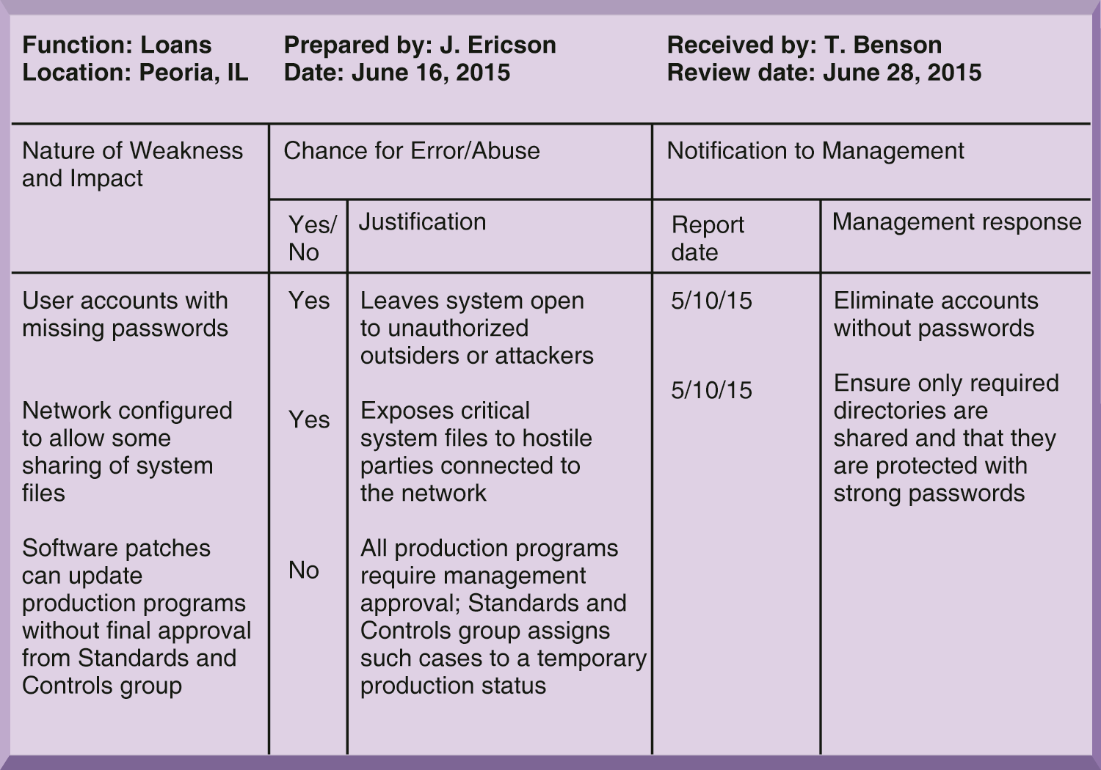
SAMPLE AUDITOR’S LIST OF CONTROL WEAKNESSES
This chart is a sample page from a list of control weaknesses that an auditor might find in a loan system in a local commercial bank. This form helps auditors record and evaluate control weaknesses and shows the results of discussing those weaknesses with management, as well as any corrective actions taken by management.
FIGURE 8-4
Notes:
This graphic illustrates a sample page from an auditor’s listing of control weaknesses for a loan system. It includes a section for notifying management of such weaknesses and for management’s response. Management is expected to devise a plan for countering significant weaknesses in controls.
‹#›

Slide 28
Tools and Technologies for Safeguarding Information Resources
Firewall:
Combination of hardware and software that prevents unauthorized users from accessing private networks
Notes:
This slide looks at an essential tool used to prevent intruders from accessing private networks—firewalls. To create a strong firewall, an administrator must maintain detailed internal rules identifying the people, applications, or addresses that are allowed or rejected. Firewalls can deter, but not completely prevent, network penetration by outsiders and should be viewed as one element in an overall security plan.
Ask students to differentiate between the screening technologies listed here. Note that these are often used in combination. Ask students if they use firewall software on their own computers.
‹#›

Slide 29
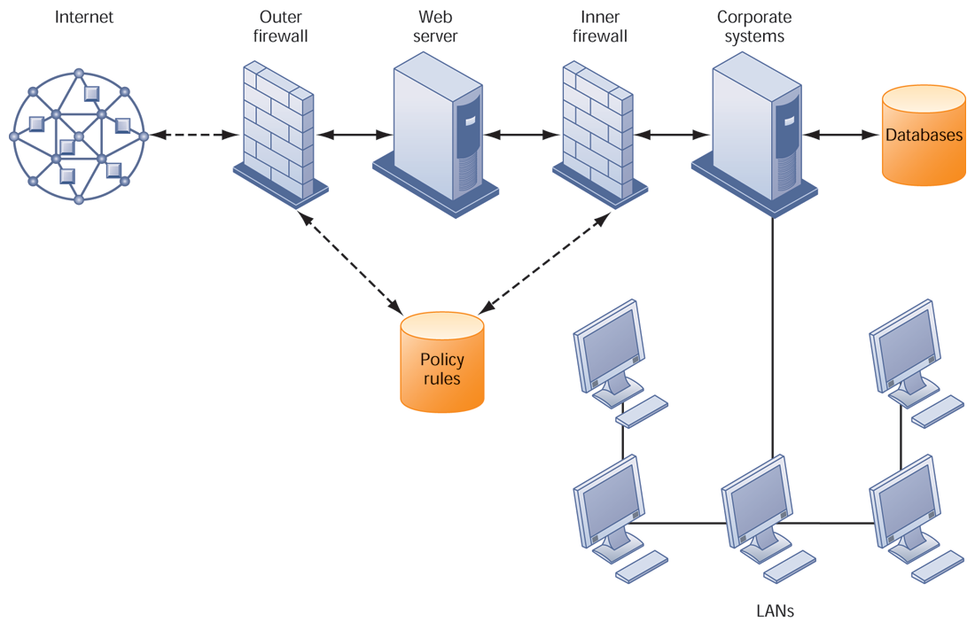
A CORPORATE FIREWALL
FIGURE 8-5
The firewall is placed between the firm’s private network and the public Internet or another distrusted network to protect against unauthorized
traffic.
Notes:
This graphic illustrates the use of firewalls on a corporate network. Notice that here, a second, “inner” firewall protects the Web server from access through the internal network.
‹#›

Slide 30
Tools and Technologies for Safeguarding Information Resources
Intrusion detection systems:
Monitors hot spots on corporate networks to detect and deter intruders
Examines events as they are happening to discover attacks in progress
Antivirus and antispyware software:
Checks computers for presence of malware and can often eliminate it as well
Requires continual updating
Notes:
This slide looks at additional tools to prevent unwanted intruders and software from accessing the network. Ask students what antivirus and antispyware tools they use. Ask why these tools require continual updating. Ask why UTM packages would include anti-spam software.
‹#›

Slide 31
Tools and Technologies for Safeguarding Information Resources
Encryption:
Transforming text or data into cipher text that cannot be read by unintended recipients
Two methods for encryption on networks
Secure Sockets Layer (SSL) and successor Transport Layer Security (TLS)
Secure Hypertext Transfer Protocol (S-HTTP)
Notes:
This slide introduces the use of encryption to ensure that data traveling along networks cannot be read by unauthorized users. Ask students what encryption involves: use of encryption key (a numerical code) that is used to transform a message into undecipherable text. The cipher text requires a key to decrypted and read by the recipient.
‹#›

Slide 32
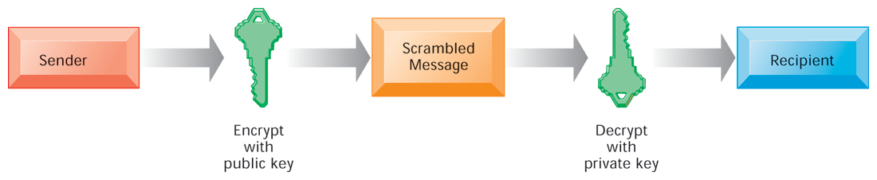
PUBLIC KEY ENCRYPTION
FIGURE 8-6
A public key encryption system can be viewed as a series of public and private keys that lock data when they are transmitted and unlock the data when they are received. The sender locates the recipient’s public key in a directory and uses it to encrypt a message. The message is sent in encrypted form over the Internet or a private network. When the encrypted message arrives, the recipient uses his or her private key to decrypt the data and read the message.
Notes:
This graphic illustrates the steps in public key encryption. The sender encrypts data using the public key of the recipient; data encrypted with this public key can only be decrypted with the recipient’s private key.
‹#›

Slide 33
Tools and Technologies for Safeguarding Information Resources
Ensuring system availability
Online transaction processing requires 100% availability, no downtime
Fault-tolerant computer systems
For continuous availability, for example, stock markets
Contain redundant hardware, software, and power supply components that create an environment that provides continuous, uninterrupted service
Notes:
This slide and the next look at technologies and tools for ensuring system availability. Ask students why online transaction processing requires 100% availability. Note that firms with heavy e-commerce processing or for firms that depend on digital networks for their internal operations require at minimum high-availability computing, using tools such as backup servers, distribution of processing across multiple servers, high-capacity storage, and good disaster recovery and business continuity plans.
‹#›

Slide 34
Tools and Technologies for Safeguarding Information Resources
Ensuring software quality
Software metrics: Objective assessments of system in form of quantified measurements
Number of transactions
Online response time
Payroll checks printed per hour
Known bugs per hundred lines of code
Early and regular testing
Walkthrough: Review of specification or design document by small group of qualified people
Debugging: Process by which errors are eliminated
Notes:
This slide looks at ensuring software quality as a way to improve system quality and reliability by employing software metrics and rigorous software testing. Ongoing use of metrics allows the information systems department and end users to jointly measure the performance of the system and identify problems as they occur.
‹#›

Slide 35
“Dark Side” of Information Technology Use
Recent studies conducted by professional/industry bodies reveal interesting and often alarming evidence about how IT is being used. For instance, 43 percent of users find the use of smart phones stressful; 60 percent of users cannot go for an hour without checking their phones for messages and email; 30 percent of users check their smart phones at meals, 24 percent while driving, and 54 percent in the middle of the night or immediately upon waking up.

Slide 36
According to one study, people spend as much as 28 percent of their workday on IT-related interruptions, which may translate into huge monetary and psychological costs, while a separate study reports that it takes approximately twenty minutes to get back to the original task after the interruption.
More alarmingly, 50–75 percent of all information security breaches stem from misuse by users/employees. Such evidence indicates an emerging contrast in IT-enabled patterns of work and collaboration: that of quick and easy information access and flexible work patterns versus addiction, misuse, overuse, and stressful use.

Slide 37
“Dark Side” of Information Technology Use
Digital divide
technostress,
information overload,
technology “addiction,”
misuse.

Slide 38
Digital Divide
A digital divide is an economic and social inequality with regard to access to, use of, or impact of information and communication technologies (ICT). The divide within countries (such as the digital divide in the United States) may refer to inequalities between individuals, households, businesses, or geographic areas, usually at different socioeconomic levels or other demographic categories. The divide between differing countries or regions of the world is referred to as the global digital divide, examining this technological gap between developing and developed countries on an international scale

Slide 39
Technostress
Technostress is defined as the stress caused by an inability to adapt to or cope with IT in a healthy manner. The increasing incidence of technostress is attributable to employees’ growing dependence on technology (computing and communication devices, enterprise applications, collaborative applications, connectivity tools) in almost all aspects of organizational life.

Slide 40
Information overload
Information overload, an undesirable condition that occurs when the information to be processed exceeds one’s information processing capacity, is one of the strongest predictors of workplace stress and job turnover.

Slide 41
TECHNOLOGY-RELATED “ADDICTIONS”
In some IT-use contexts, users may develop a strong maladaptive psychological dependency on using a technology artifact, which can result in a pattern of excessive IT-seeking and IT-use behaviors that take place at the expense of other important activities, and deteriorates individuals’ normal functioning. This phenomenon which can be termed “addiction” can form when one uses a system that provides strong hedonic rewards. Examples of such systems include online video games, mobile email, social networking, and online gambling websites. Even though in such IT-use situations the rewards do not come from substances, there is a risk that vulnerable brains develop a strong maladaptive dependency on the rewarding behavior.

